Slide 1
Video-Based Questions
#VBQs @MsGrotrian
Kelly Grotrian / East Brunswick High School (NJ)
or… what does Student Engagement look like in your classroom?

Slide 2
Student engagement

Slide 3
What are students “in to” these days?
Technology
Videos
Personal Devices

Slide 4
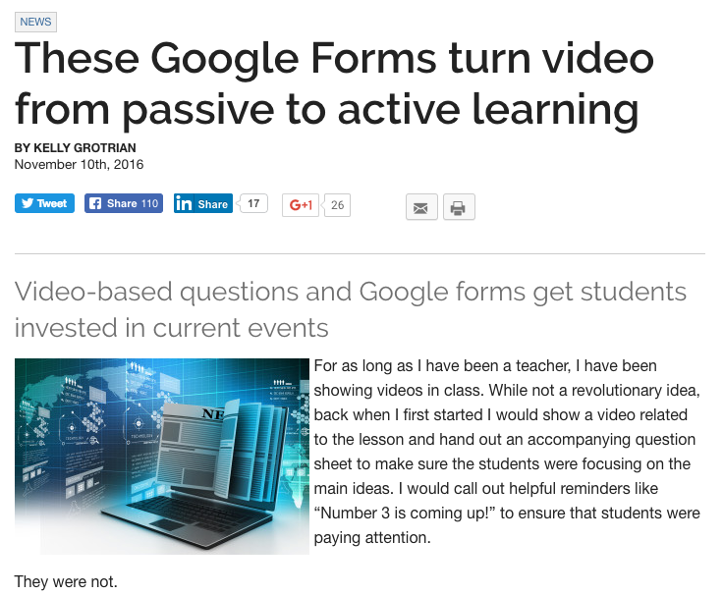

Slide 5
Video-Based Questions (#VBQs)
What I use:
Google forms
Video / Media
Internet connection
Chromebooks/device
headphones

Slide 6
Why not use other tools?
Google Forms is simple.
EDpuzzle is not what I want – it inserts the question directly into the video which could deter students from focusing on the video until the question appears.
Like…

Slide 7
Let’s make a video-based question activity together!
If you’re on twitter, I recommend searching #vbqs to see what I and others have posted about the project!

